Slide 1
Comparing Two Groups
Jamil Bhanji
with help from Vanessa LoBue
and Andy Field

Slide 2
Aims
t-tests
Dependent (paired-samples, matched-pairs)
Independent
Rationale for the tests
Nonparametric Tests

Slide 3
Experiments
The simplest form of an experiment is with only one independent variable that is manipulated to yield only two levels and only one (continuous) outcome is measured.
E.g., experimental condition vs. control, one outcome measure
means of each IV level can be compared with a t-test

Slide 4
T-test
Independent samples t-test
Compares two means based on independent data
E.g., data from different groups of people
Dependent samples t-test
Compares two means based on related data.
E.g., Same people measured at different times, Data from ‘matched’ samples.

Slide 5
Rational for the t-test
Two samples are collected and the means calculated
These means might differ by either a little or a lot
If the samples come from the same population (this is the null hypothesis), we would expect large differences between sample means to occur very infrequently.
How large is a large difference? The standard error of the mean tells us how much we expect a sample mean to vary

Slide 6
Rational for the t-test
If the difference between the samples is larger than we would expect based on the standard error then one of two things has happened:
1. The two samples come from the same population (null hypothesis, no true effect) but because sample means fluctuate we happen to have collected two samples that produce different means
2. The two samples come from different populations. In other words, the null hypothesis is unlikely
Notes:
The larger the observed difference between the sample means (relative to the standard error), the more likely it is that the two sample means differ because of the different testing conditions imposed on each sample.

Slide 7
Assumptions of the t-test
Both the independent t-test and the dependent t-test are parametric tests based on the normal distribution
Both are instances of the General Linear Model (GLM), like correlation and linear regression
Assumptions:

Slide 8
GLM Assumptions (a reminder…)
Additivity and linearity
Homoscedasticity (homogeneity of variance): For each value of the predictors the variance of the error term should be constant
Independent residuals: the error terms should be unrelated.
Normally-distributed residuals
Notes:
Normal errors: the differences between the predicted and observed data are most frequently zero or very close to zero, and that differences much greater than zero happen only occasionally. Some people confuse this assumption with the idea that predictors have to be normally distributed, which they don’t.
In small samples a lack of normality invalidates confidence intervals and significance tests, whereas in large samples it will not because of the central limit theorem. If you are concerned only with estimating the model parameters (and not significance tests and confidence intervals) then this assumption barely matters. If you bootstrap confidence intervals then you can ignore this assumption.

Slide 9
GLM Assumptions applied to the t-test
Additivity and linearity – only one predictor (IV group) and 2 levels so these are always satisfied
Homogeneity of variance
Independent samples t-test: Variance at each level of the IV should be equal
Dependent samples t-test: always satisfied because we are concerned with variance of the difference between IV levels
Independent residuals
Independent samples t-test: distances of each point from its group mean are unrelated
Dependent samples t-test: differences between levels for each point are unrelated
Normally distributed residuals
Independent samples: distances of each point from its group mean are normally distributed
Dependent samples: differences between levels for each point are normally distributed

Slide 10
Assumptions
The outcome is measured at least at the interval level. For ordinal data, see “Non-parametric tests”

Slide 11
Non-Parametric Tests
Mann-Whitney/Wilcoxon rank-sum Test
Compares two independent groups of scores
Wilcoxon signed rank Test
Compares two dependent groups of scores
Notes:
When data violate the assumptions of parametric tests we can sometimes find a nonparametric equivalent

Slide 12
Ranking Data
Non-parametric tests work on the principle of ranking the data for each group:
Lowest score = a rank of 1,
Next highest score = a rank of 2, and so on.
Tied ranks are given the same rank
The analysis is carried out on the ranks rather than the actual data.

Slide 13
Effect size
The “strength” of an effect
How different are two means?
How closely associated are two variables?
How much outcome variance do(es) the predictor(s) explain?
Not dependent on sample size
t-stat, F-stat, X², W, U are not effect sizes
Mean difference, covariance, (unstandardized) regression beta coefficients are unstandardized effect size measures
Cohen d, r, 𝜌, r², η², Cohen f, Hedge’s g, Glass’s Δ are common standardized effect size measures

Slide 14
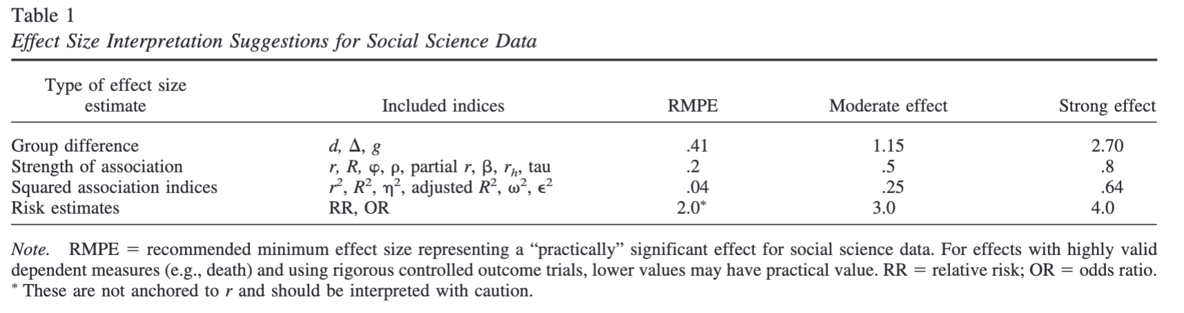
Effect sizes (Ferguson)

Slide 15
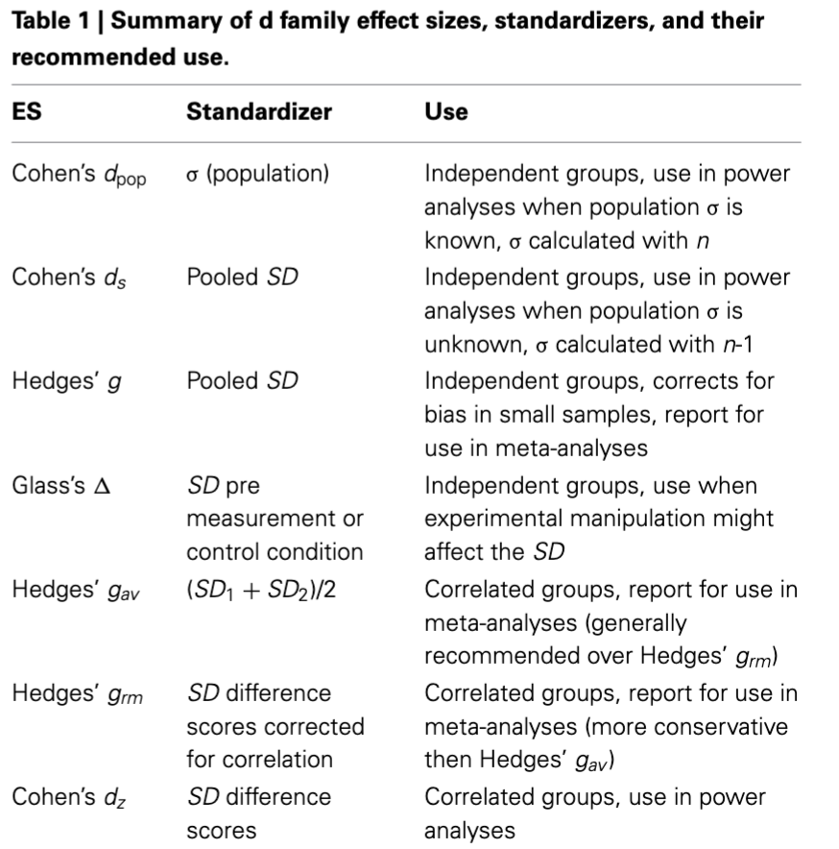
Effect sizes (Lakens)

